Slide 1

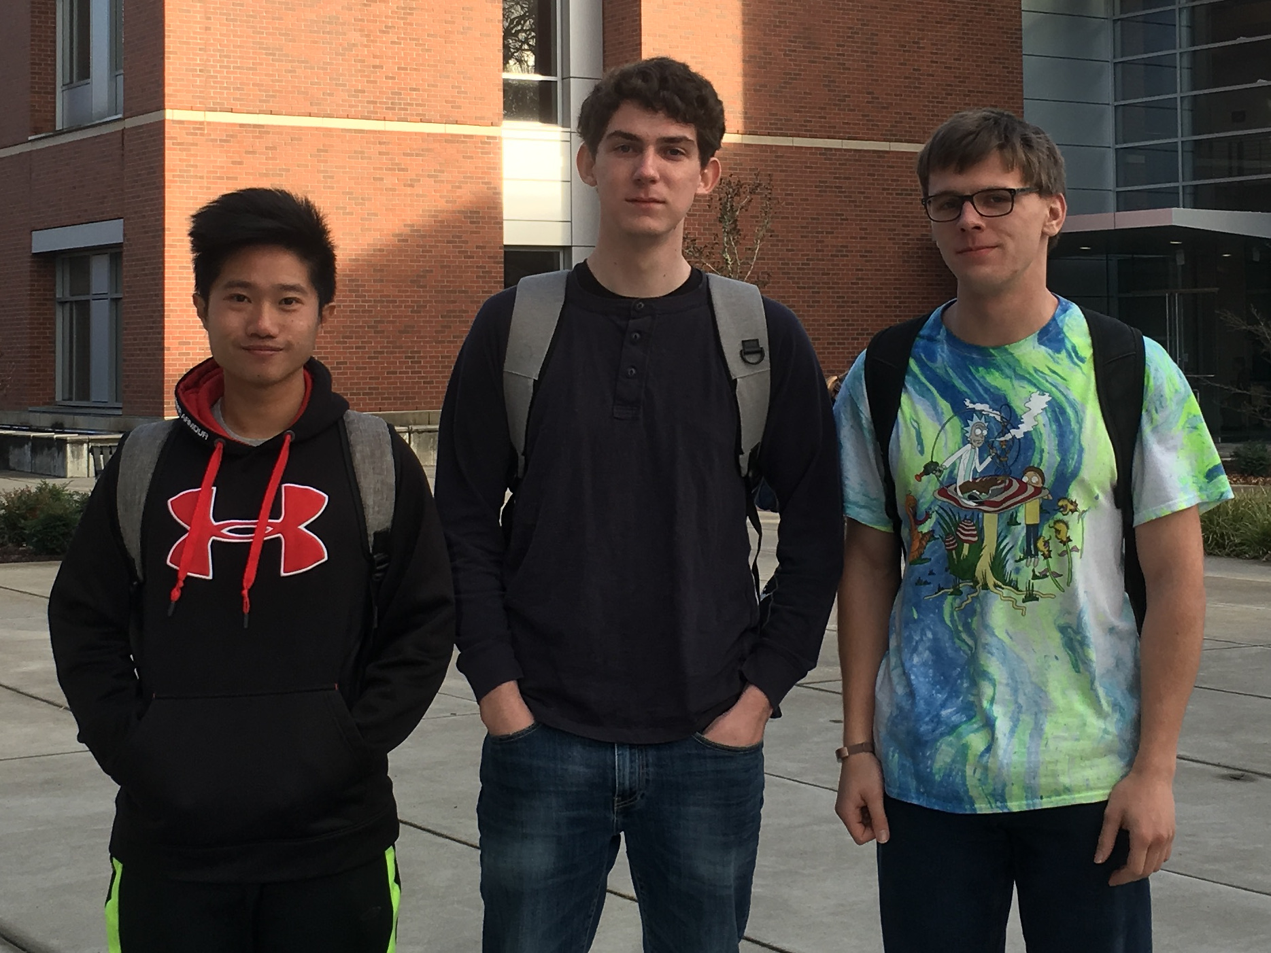
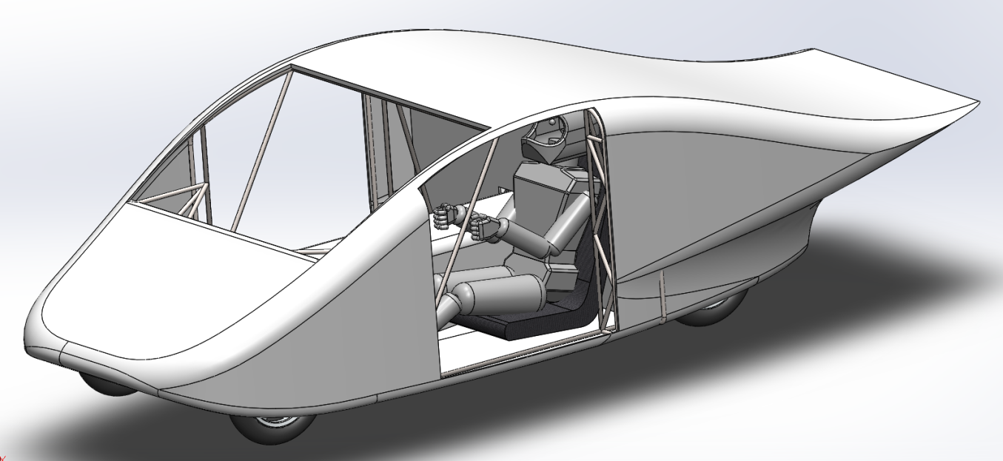
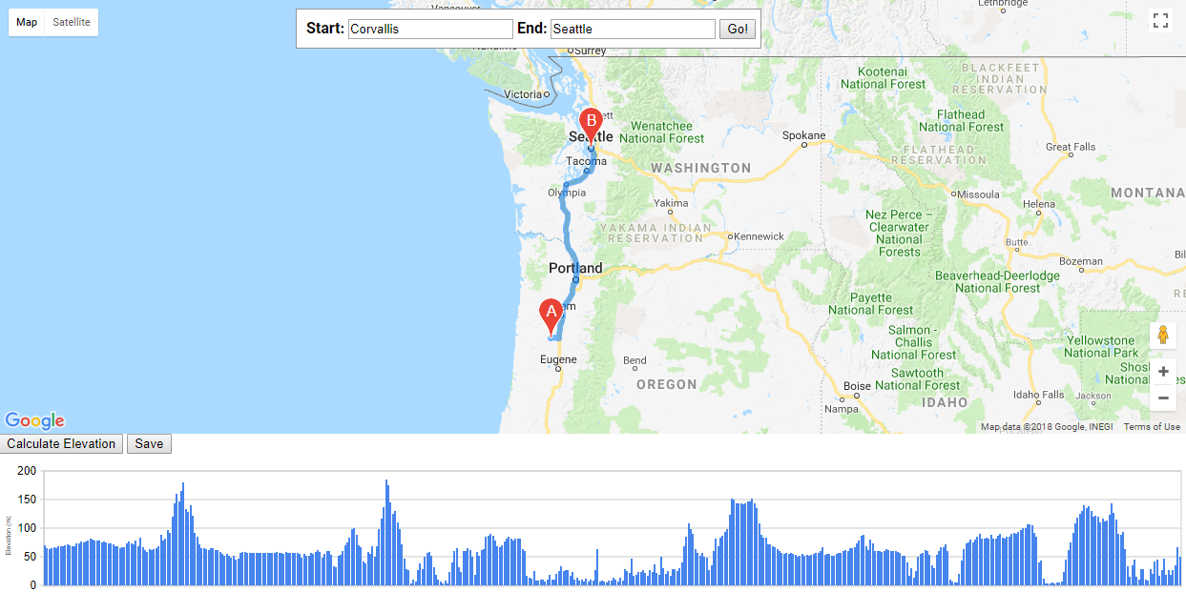
CS43
Solar Car Simulation
Harness the power of the sun!
Why?
Team Members Pictured (from left to right): Dennie Devito, Dakota Zaengle, Logan Kling
devitod@oregonstate.edu
zaengled@oregonstate.edu
klinglo@oregonstate.edu
The OSU Solar Racing Team would like to test how their car will run in a race.
The race is nearly 2000 miles!
It’s not feasible to test this by driving the car 2000 miles before each race.
Shorter test races are an option but have several disadvantages, such as not accounting for weather or varying incline.
This is where we come in!
A 2000 mile simulation can be run in under a minute.
Weather can be set or defined from a path on the map based on the current date.
The parameters of the solar car, (charge, weight, etcetera) can be modified from a simple input file as opposed to the complications involved with making such modifications to the solar car.
Client: Caitlin Moore of OSU’s Phoenix Solar Racing Team
phoenixsolarracing@gmail.com
About:
GUI:
Should be simple with:
Form fields
A nice big graph for output
Hardware specs that are saved to a text file to be easily updated
Data We Included or Calculated:
Weather conditions
Difference in altitude from start to end
Physical constraints (drag, weight, rolling friction, wheel size, ecetera)
The initial battery charge in KWH (Kilowatt-Hours)
Set time and or speed for the car
With a given amount of energy, what speed is best to make it a given distance
Performance metrics:
The car is not finished to test.
As a result, we have used past race data.
We made calculations based on the individual hardware.
Results
Conclusion
A program which can calculate the distance with a set of altitudes between two points.
A program which can use that data to calculate the best speed for the solar car going along that route.
This was a fun experience, albeit stressful and confusing at times. The result of this is a working program which can be used by OSU’s Phoenix Solar Racing team for many iterations of the solar powered car.
A program with the flexibility to simulate a plethora of solar vehicle designs.

